Slide 1
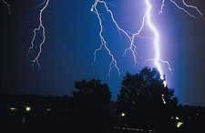
Weather Patterns
Data Analytics and Visualization Final Project
John Bates | Brittany Woolard | Danielle Duce | Lakenia Manago

Slide 2
Purpose
Analyze weather patterns among the east coast
Predict the likelihood of bad weather
Provide analysis for meteorologist

Slide 3
Data Exploration Phase
Questions we want to answer
Finding the best data the fits what we need

Slide 4
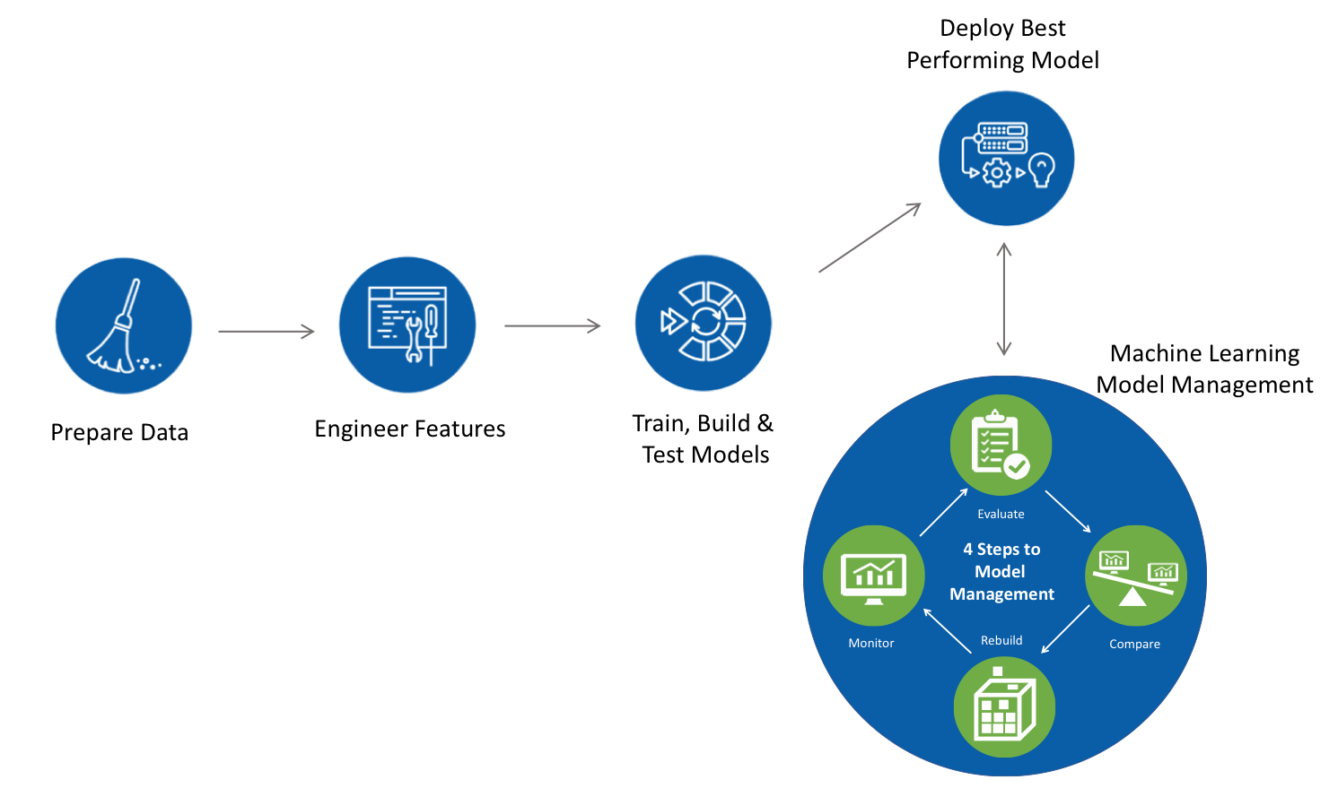
Machine Learning Pipeline

Slide 5
Database Structure
Entity Relationship Diagram

Slide 6
Data Analysis
Visualize the Data
Tableau Dashboard

